Slide 1
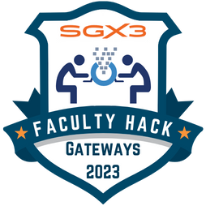


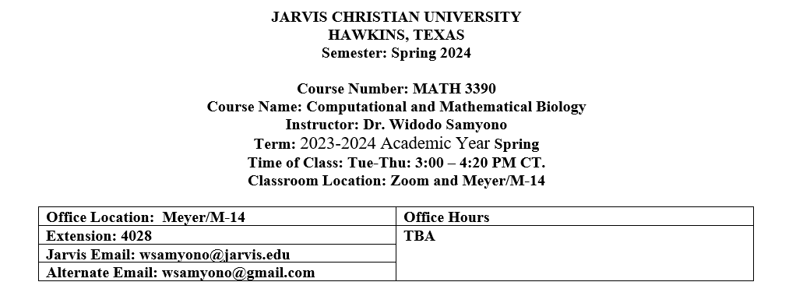
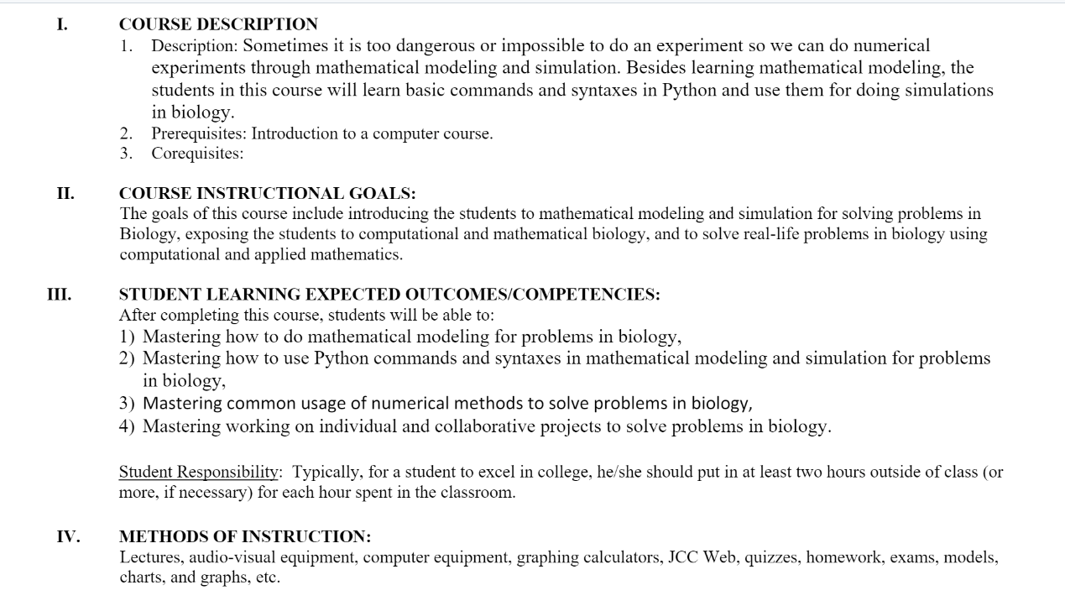
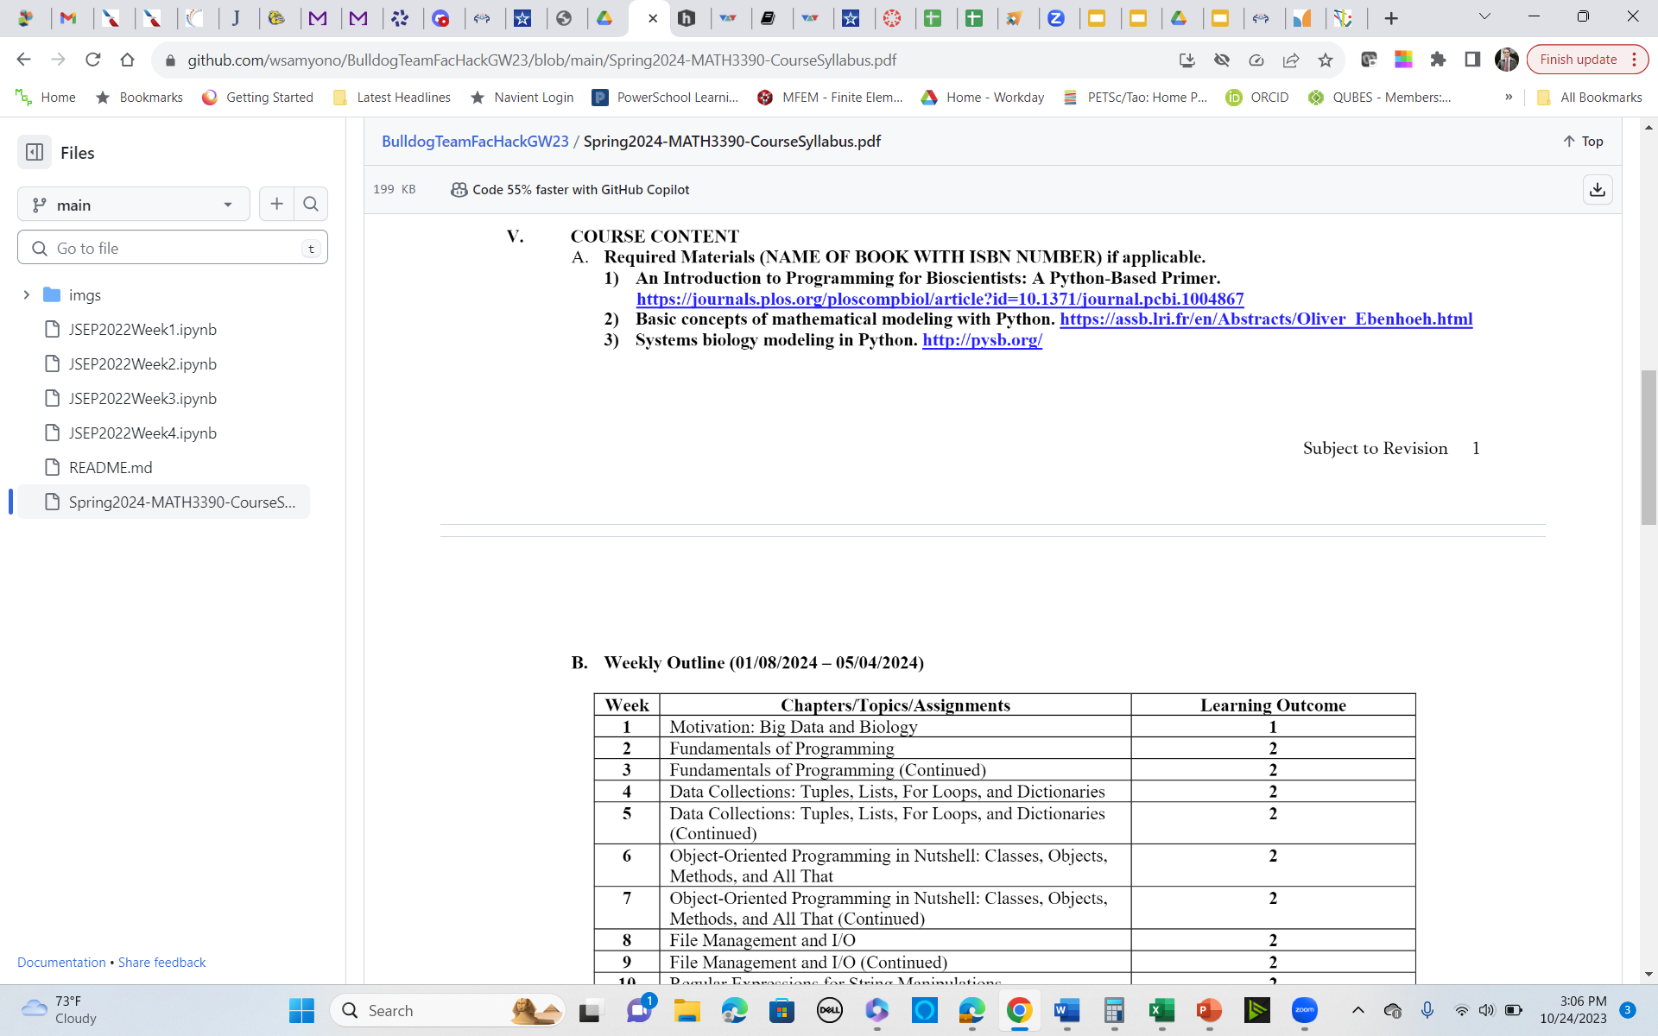
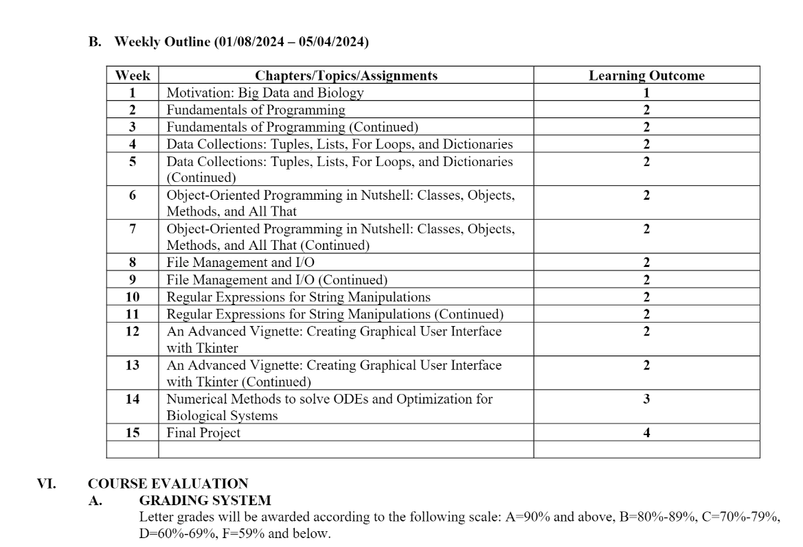
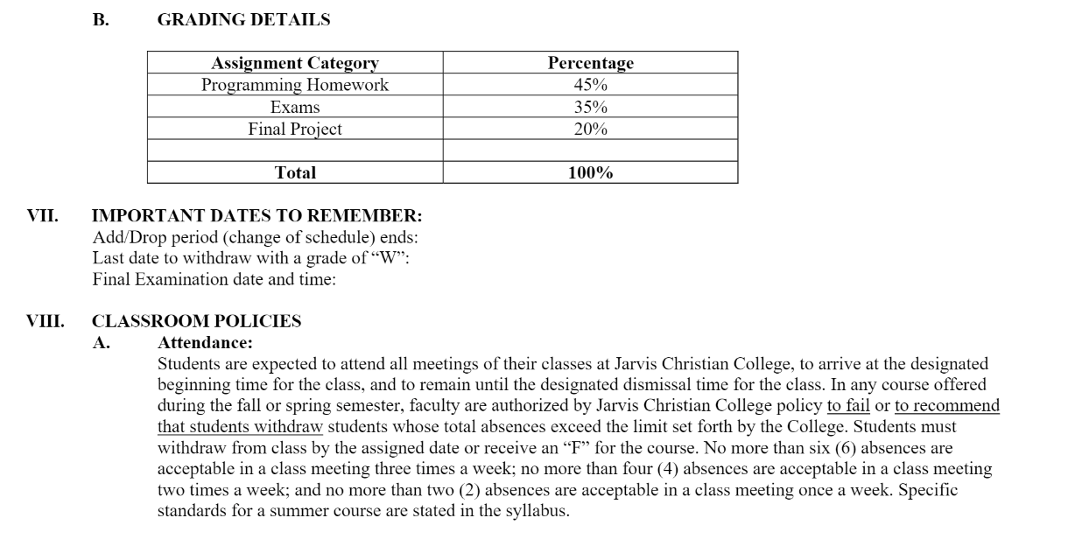



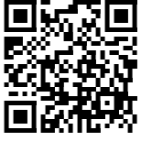
Title: Computational and Mathematical Biology in HPC Science Gateways
SGX3 award # 2231406
Revised Course Description
Sample HPC/Gateways Exercise
Gateway Community Mentor Syllabus Suggestions
In some cases, it is too dangerous or impossible to do an experiment, so we can do numerical experiments through mathematical modeling and simulation. Besides learning mathematical modeling, the students in this course will learn basic commands, syntaxes, and fundamental programming in Python and use them for solving problems in biology. The course targeted students having major in mathematics, and biology and chemistry with minor in mathematics who are interested in learning computational and mathematical biology. The course consists of 3 parts: 1) fundamental programming in Python, 2) computational biology, and 3) mathematical biology.
Exercises 7 and 12 are from this journal paper: https://doi.org/10.1371/journal.pcbi.1004867
Exercise 7:
Consider the fermentation of glucose into ethanol: C6H12O6 → 2C2H5OH + 2CO2. A fermenter is initially charged with 10,000 liters of feed solution and the rate of carbon dioxide production is measured by a sensor in moles/hour. At t = 10, 20, 30, 40, 50, 60, 70, and 80 hours, the CO2 generation rates are 58.2, 65.2, 67.8, 65.4, 58.8, 49.6, 39.1, and 15.8 moles/hour, respectively. If each reading represents the average CO2 production rate over the previous ten hours, calculate the total amount of CO2 generated and the final ethanol concentration in grams per liter. Note that Supplemental Chapters 6 and 9 might be useful here.
Exercise 12 (cumulative project):
First, obtain a set of several hundred protein structures from the PDB, as plaintext .pdb files (the exact number of entries is immaterial). Then, from this pool of data, determine the relative frequencies of the constituent amino acids for each protein secondary structural class; use only the three descriptors “helix,” “sheet,” and, for any AA not within a helix or sheet, “irregular.” (Hint: In considering file parsing and potential data structures, search online for the PDB’s file-format specifications.) Output your statistical data to a human-readable file format (e.g., comma-separated values, .cvs) such that the results can be opened in a statistical or graphical software package for further processing and analysis. As a bonus exercise, use Python’s matplotlib package to visualize the findings of your structural bioinformatics analysis.
We created Exercise 13 by ourselves.
Exercise 13: Use the provided data from the in vitro experiments, by which the biology student inducing nanoparticles into cancer cells, to do mathematical modeling for predicting the cancer growths and observing the effects of nanoparticles for the cancer treatments and responses. Use the classical mathematical models from the literatures. To solve the problem, set the problems as differential equations constrained optimization problems that we learned from the class. Use the code template to start the Python coding.
Resources / Science Gateways
SGX3 Science Gateways https://sciencegateways.org/education-training/resources#/ We may use some resources for training the students.
Design Safe Gateways https://www.designsafe-ci.org/
We may use some of the modules to expand our course.
3.Texas Advanced Computing Center (TACC) https://www.tacc.utexas.edu/ We may use the machine to run the students’ codes.
4.Jetstream2 https://jetstream-cloud.org/index.html
We use the resources for running Jupiter Notebook.
5.ACCESS https://access-ci.org/ We may use the platform to collaborate with other faculty from different institutions.
Use Cases
By using Python, determine the relative frequencies of constituent amino acids for each protein secondary structural class from the Protein Data Bank (PDB). See the Datasets column.
By using Python, research the best fit model for the data from in vitro experiments in which nanoparticles induced into cancer cells in biology laboratory at Jarvis Christian University, Hawkins, Texas.
Datasets
RCSB PDB Protein Data Bank: https://www.rcsb.org/
Genomic Data Commons Data Portal: https://portal.gdc.cancer.gov/
Data from students in Biology conducting in vitro experiments by inducing nanoparticles into cancer cells. Data can be acquired directly from the students and the biology faculty members.
Other biology data from Science Gateways.
Resource Needs/List
1) Google Colab. The students use it for programming in Python to introduce the students with Python coding without installing Python in their computers. https://colab.research.google.com/
2) Jupiter Notebook. The students may use TACC and Jetstream2 Resources for using the Jupiter Notebook. https://www.tacc.utexas.edu/ https://jetstream-cloud.org/
3) Anaconda Navigator. The students may experience installing it in their own computers. The link is this: https://docs.anaconda.com/free/navigator/index.html
4) Python. The students need to learn this popular language to solve problems in biology. This is the link: https://www.python.org/
5) SciPy. The students need to learn algorithms in solving biological problems. This is the link: https://scipy.org/
6) scikit-learn (sklearn). Simple and efficient tools for machine learning. They students may use it in the future. The link is this: https://scikit-learn.org/stable/
7) GitHub. The students need to collaborate in solving biological problems, so they can use it to share codes. The link to our GitHub repository is this: https://github.com/wsamyono/BulldogTeamFacHackGW23
Possible Expansions
The course could be expanded to more advanced topics in the future by adding some more modules and new recent science gateways resources, and literatures.
We may collaborate with other faculty from different institutions to teach and conduct research in computational and mathematical biology.
Authors
Author
Photo
Team Member
Widodo Samyono, PhD
Mathematics Department,
Jarvis Christian University
wsamyono@jarvis.edu
Implementation Schedule
HPC/Gateways Mentor
jpowell@tacc.utexas.edu
Texas Advanced Computing Center
Spring 2024, January 8, 2024 – May 3, 2024.
Summer 2024, June 3, 2024 – June 28, 2024.
Spring 2025, January 6, 2025 – May 2, 2025.
Summer 2025, January 2, 2025 – June 27, 2025.
Author 2
Photo
Your feedback is welcome!
MORE INFORMATION → https://hackhpc.github.io/facultyhack-gateways23 __

